Slide 1
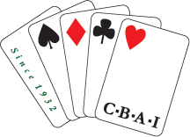
CONTRACT BRIDGE ASSOCIATION OF IRELAND
Chief Executive’s Report
Season 2025/2026
Presented to
Annual General Meeting
27 June 2026

Slide 2
Introduction
2025/26 another positive year
Membership numbers up by almost 4.5%
Nearly all regions registered increases
National competitions very well-attended
Congress numbers grew substantially
Generated a healthy financial surplus (in spite of some additional spending commitments)
Lots of classes and potential new members

Slide 3
Some Statistics
Membership numbers grew in 12 of 13 regions
Growth in rural as well as urban clubs
Clear correlation between teaching and growth
14 new or returning clubs
3 clubs closed, and two merged
Two-thirds of clubs either growing or stable
19 new accredited teachers, and more than 1,250 student registrations (up on 2024/5)

Slide 4
Challenges Remain
Some clubs still struggling
Average member age > 70
Median club size 46 members
Card-playing diminishing in society
Hard to connect with younger people
Very difficult to generate publicity for bridge
Promotions tell us that you really need to play bridge to understand its appeal
New Promotion & Development Committee will focus on this

Slide 5
Competitions 2025/26
Generally very well-attended; strong growth even on previous year’s numbers
Highlights: 123 teams HW, 130 pairs MPs, 40 teams 4Fun
A few events reached capacity, so some venue changes
Congress numbers up > 18% like-for-like
Welcomed Trim Bash and Carlow (back)
Regional qualifiers (and some IBU events) were disappointments

Slide 6
Amalgamation With NIBU
Formal resolution proposed for vote later
Martin Brady will present separately on this

Slide 7
Appreciations
Our national officers & trustees
Governing Council & Management Committee
All our sub-committees
Regional officers and committees
Club officers and committees
Head office staff
Tournament Directors
Media contributors
Irish Bridge Journal editor, designer, contributors
Sponsors
All our volunteers

Slide 8
International Competitions
Won Camrose (first win since 2017)
Both Junior teams hammered everyone bar England, but finished well behind them
Lady Milne team second to England
Teltscher team third to England & EBU
World Champion in 32nd Women’s Online Festival
Junior podium in President’s Cup in Italy

Slide 9
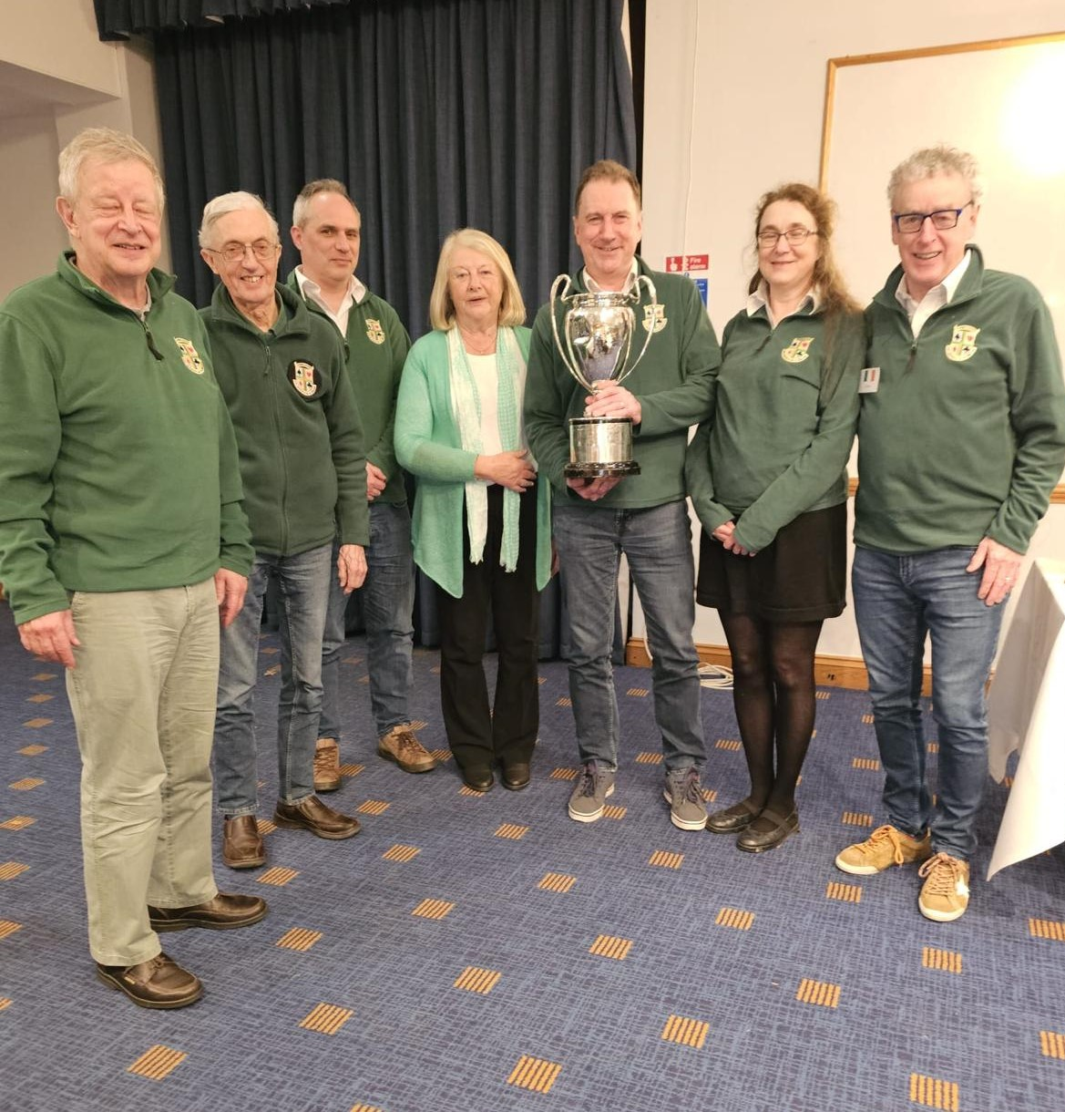
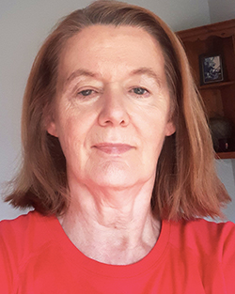
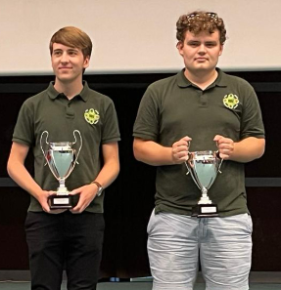
Congratulations
Camrose Winners
(plus Tom Hanlon & Conor Boland)
Deirdre
O’Halloran
Luca Crone &
Matthew O’Farrell

Slide 10
International Competitions
Good luck to the four IBU teams participating in the European Championships in Riga, Latvia:
  Open: Mark Moran, John Carroll, Adam Mesbur, Nick FitzGibbon, Conor Boland, Tom Hanlon, Grainne Barton (NPC)
  Women: Jeannie Fitzgerald (PC), Joan Kenny, Teresa Rigney, Siobhan Part, Gilda Pender, Rebecca Brown, Tommy Garvey (Coach)
  Senior: Paul Porteous, Fred Barry, Michael McAuliffe, David Dunne, Donal Garvey, Pat Quinn, Sheila Kelly (NPC)
  Mixed: Karel De Raeymaeker, Anna Onishuk, Zrinka Kokot, Pat McDaid, Lucy Phelan, John Phelan, Diarmuid Reddan (NPC)

Slide 11
New Grand Master
One new GM recognised this season

Slide 12
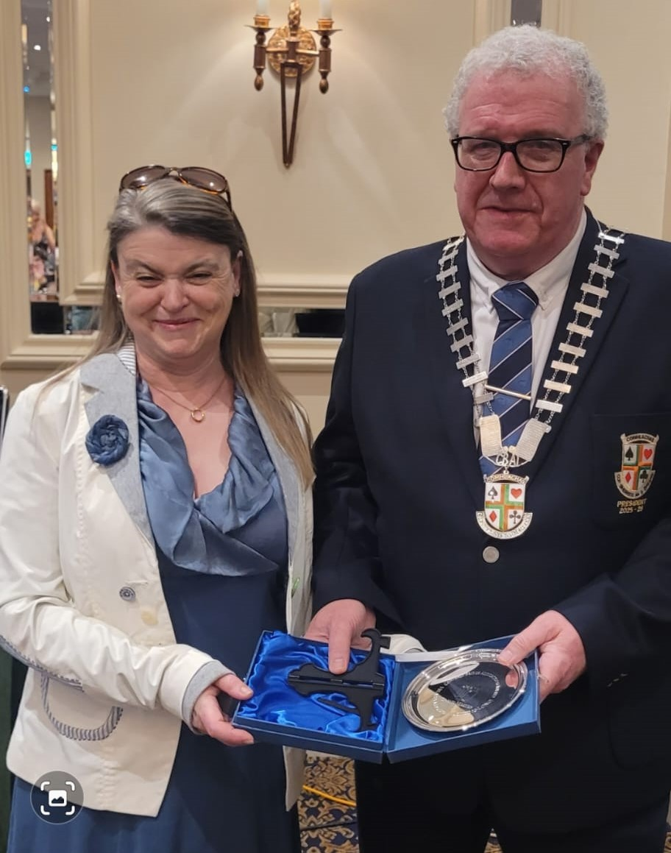
New Grand Master
One new GM recognised this season
Hilary (D-L) McDonagh (Ballaghadereen)

Slide 13
President’s Merit Award
Honours the unsung heroes of Irish bridge

Slide 14
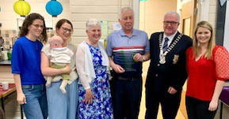
President’s Merit Award
Honours the unsung heroes of Irish bridge
Jim Doyle, stalwart of Wexford bridge, was this year’s winner

Slide 15
In Memoriam
We remember all those members who have passed away during the year, and offer our thoughts to their families and friends

Slide 16
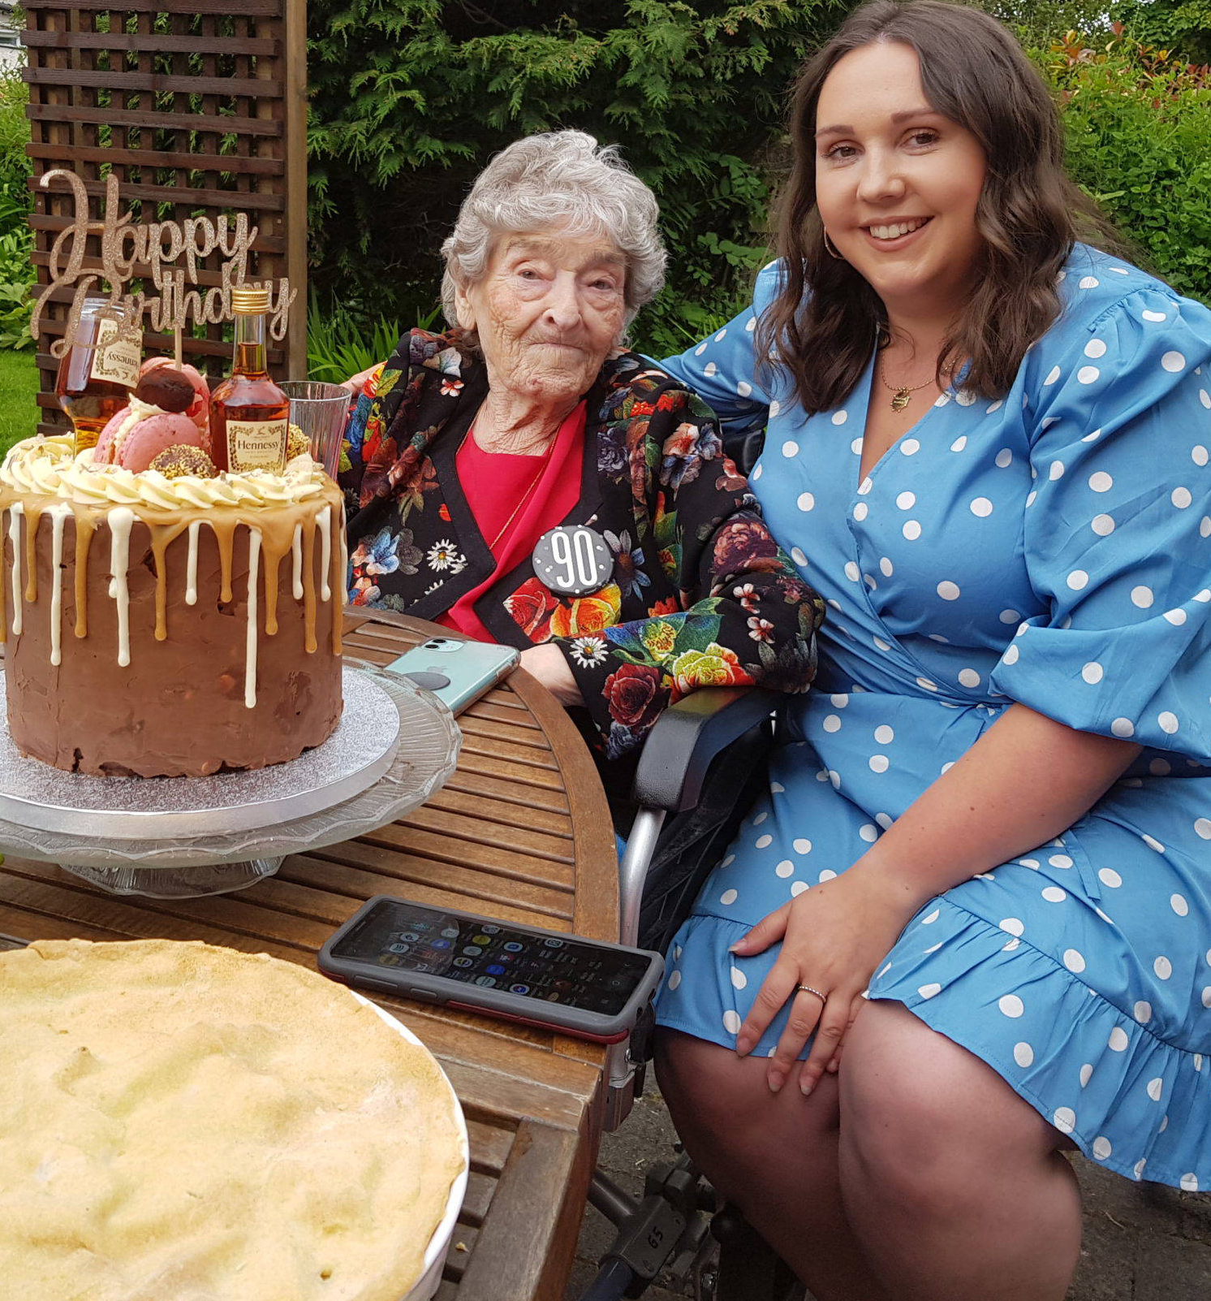
Kay Downes

Slide 17
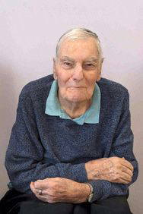
Tom Burke

Slide 18
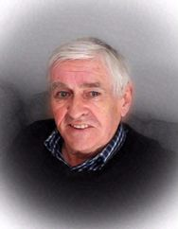
Michael MacDonagh

Slide 19
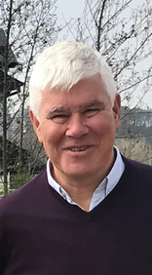
Niall Kilroy

Slide 20
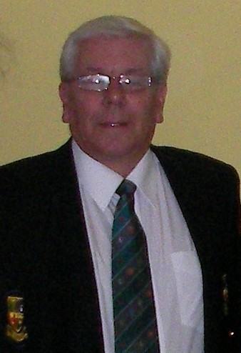
John Godden

Slide 21
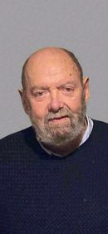
Pat McLoone

Slide 22
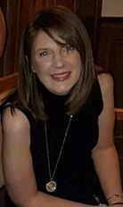
Carol Sheridan

Slide 23
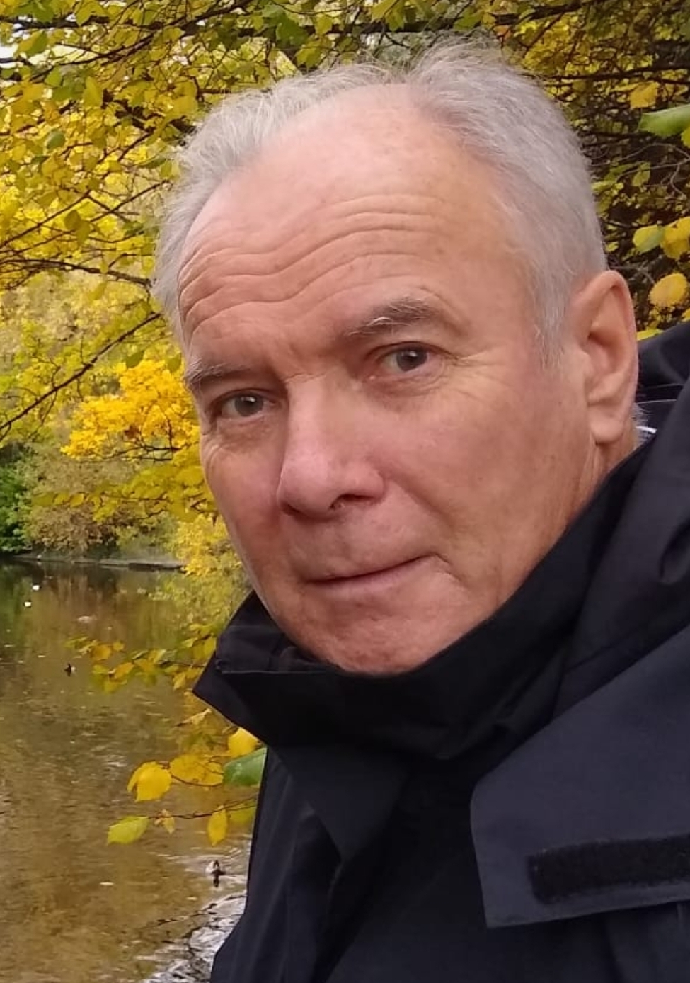
David Redmond

Slide 24
In Memoriam
We remember all those members who have passed away during the year, and offer our thoughts to their families and friends
May they, and all the Association’s deceased members, rest in peace

Slide 25
Season 2026/27
Calendar pretty much fully booked
Another very crowded season ahead
Please encourage your friends to support national competitions and congresses
Database upgrade continuing slowly
Transferring data within next week or two
Hope to have key elements available for new season
Other tasks will depend on vote later (and in Belfast)

Slide 26
THANK YOU

